Slide 1
Voltorb October - 2023

Slide 2
The Problem Statement
Voltorb October – 2023
Rashmi is a protestor who is protesting against the rising prices of food. For this she comes up with the idea for making the protest more effective: an electronic protest sign. Help her make the sign with the following requirements:
-A design for a portable and lightweight protest sign that incorporates electronic components to display dynamic text messages or slogans.
-Incorporate renewable energy sources to power the electronic components. Ensure that the sign can operate continuously.
-Design a user friendly interface for the protestors to input the messages they want to display (Using simple buttons for input)
Instructions:
- Use of microcontrollers is allowed.
- Additional functionality and creativity attracts more points.
- Both physical and simulation circuits are accepted.

Slide 3
Hints
Use LCD displays for lighter weight.
Use solar cells as the energy source.
Use rechargeable batteries to store the energy from solar cells.

Slide 4
How to Solve?
Step-1
Identify the components required to solve the given problem statement.
Step-2
Make the circuit connections.
Step-3
Write the code accordingly to get the components working.
Step-4
Test and debug, finally add extra functionality to make it fancy.

Slide 5
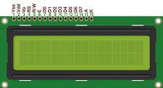
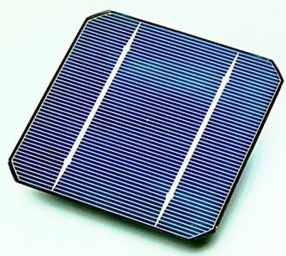
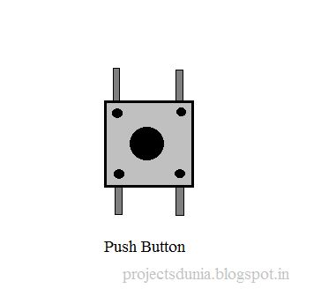
Main Components Needed
Component-1
Component-2
Component-3
A liquid-crystal display (LCD) is a flat-panel display or other electronically modulated optical device that uses the light-modulating properties of liquid crystals combined with polarizers. Liquid crystals do not emit light directly but instead use a backlight or reflector to produce images in color or monochrome.
Solar cells use the photovoltaic effect to immediately transform light energy into electrical energy. Solar cells, often known as photovoltaic cells, have been created using the photovoltaic effect.
Pushbuttons or switches connect two points in a circuit when you press them. This example turns on the built-in LED on pin 13 when you press the button.
Solar cells use the photovoltaic effect to immediately transform light energy into electrical energy. Solar cells, often known as photovoltaic cells, have been created using the photovoltaic effect.

Slide 6
Method
Use the Arduino Uno to make the necessary connections between the bread board and the LCD screen. Program it in such a way that the LCD screen shows us the necessary text.
Use a push switch(or a keypad) to ensure that the sign says what we want it to say. You can use it to switch between what we want the sign to say.
Use solar cells to make the energy source renewable, sustainable and environment-friendly. Ensure to make the sign light-weight by using a minimum number of components.
Step-1
Step-2
Step-3

Slide 7
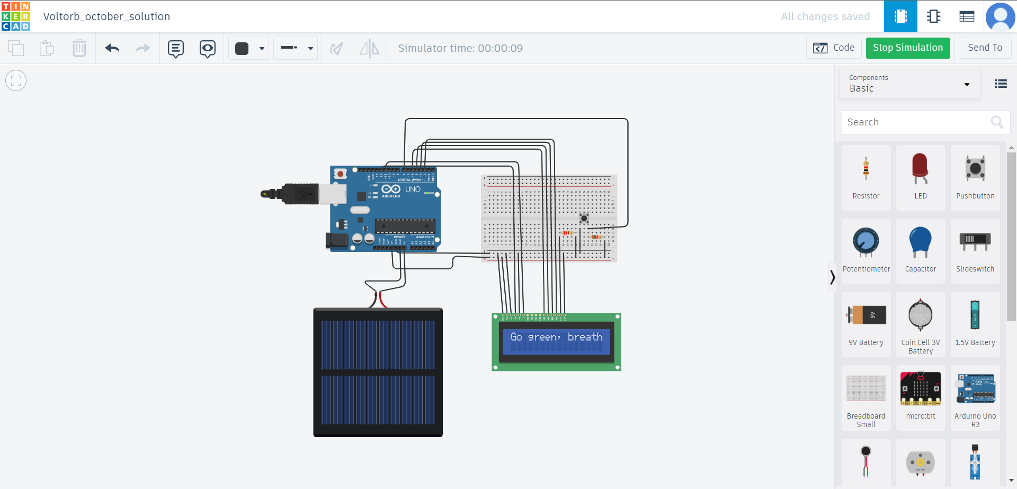
Solution Circuit
Circuit link:
https://bit.ly/Voltorb-october-2023-solution

Slide 8
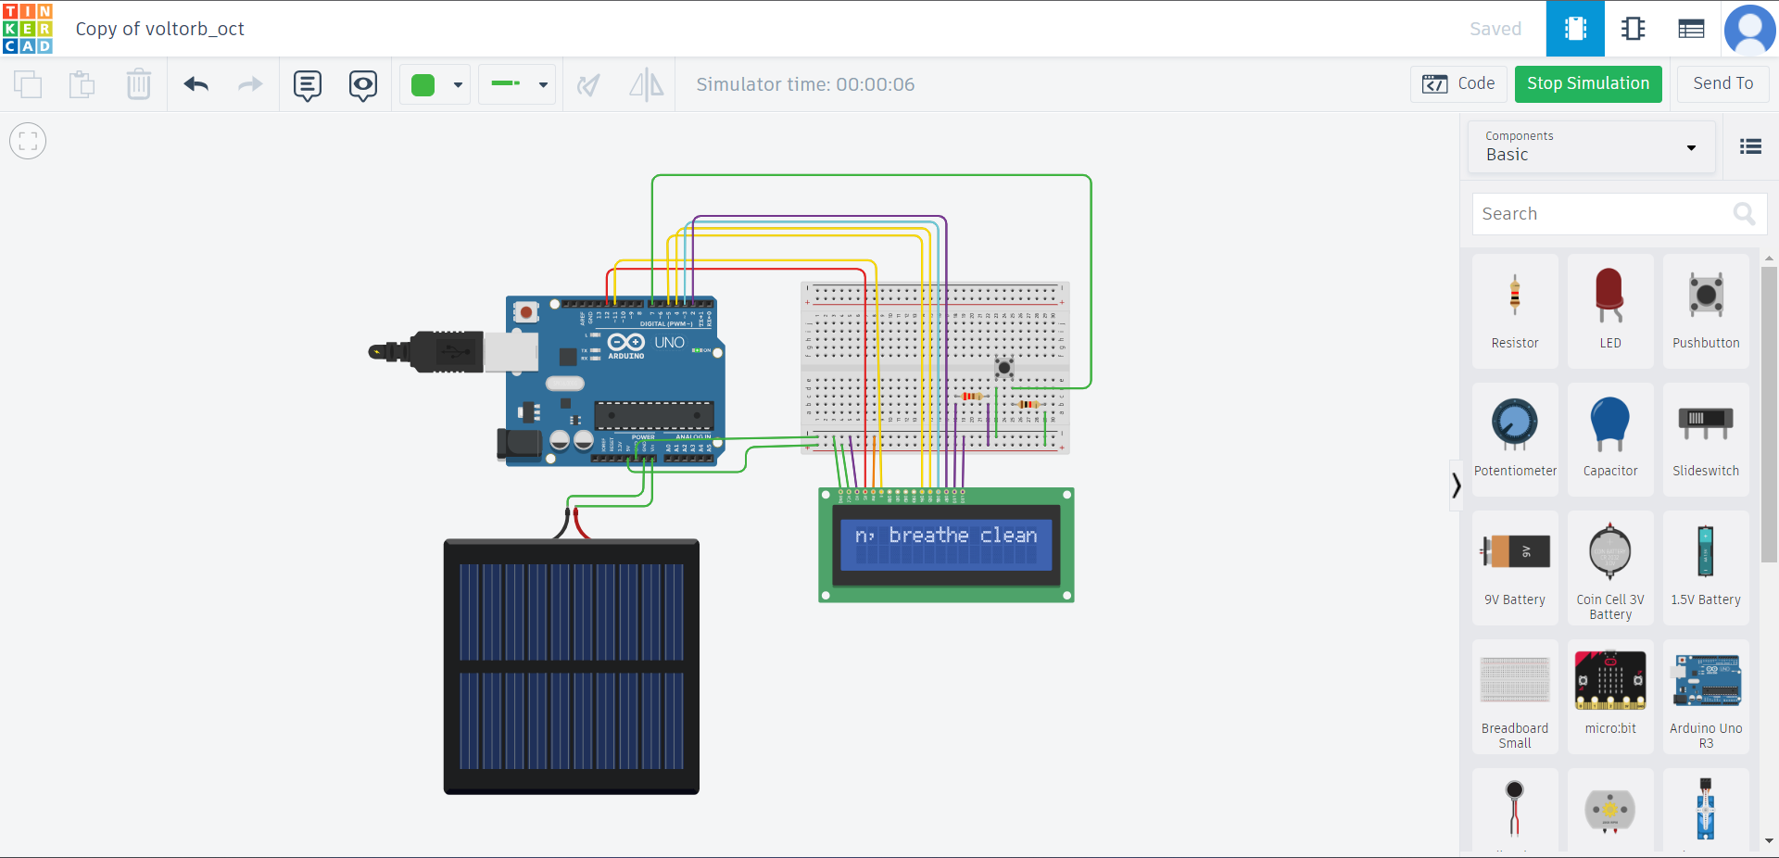
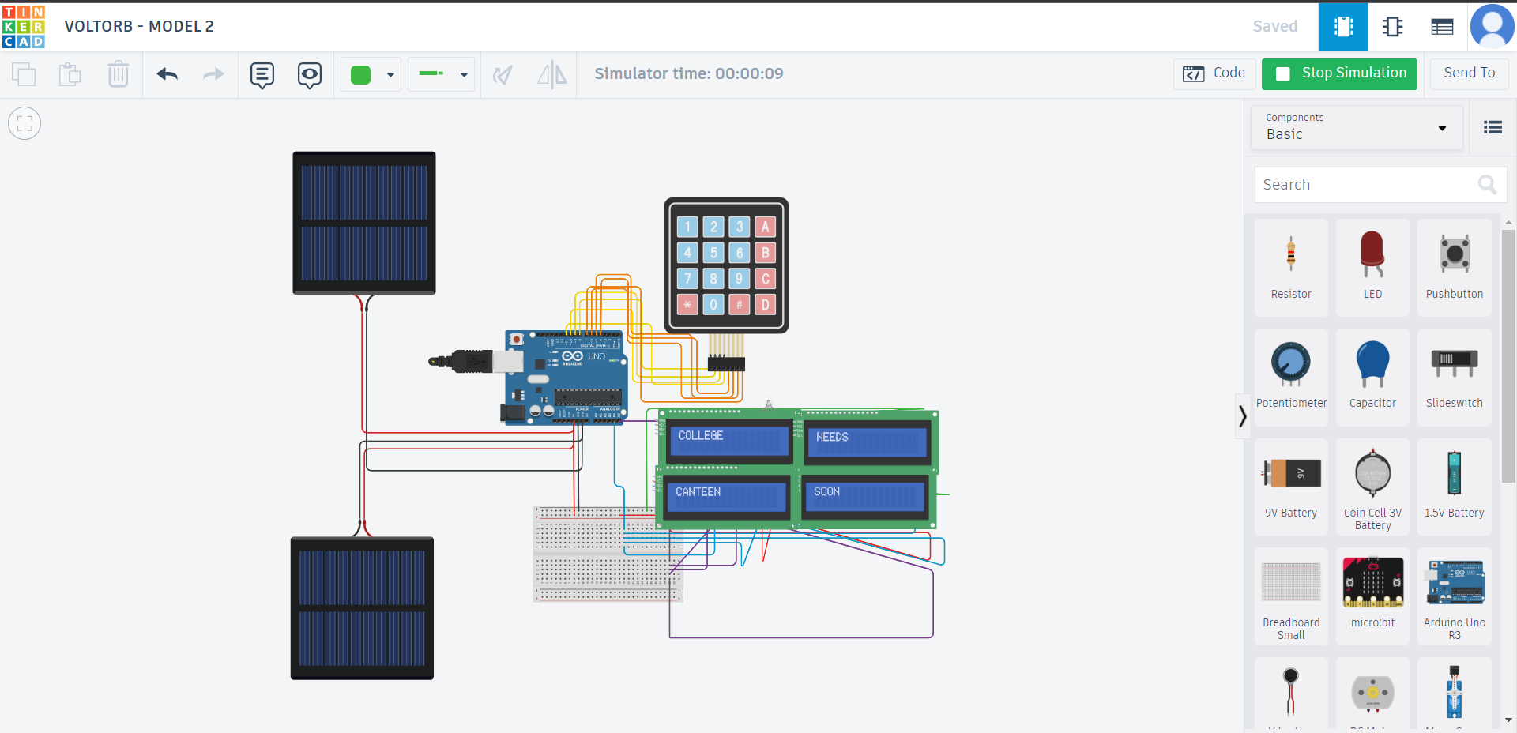
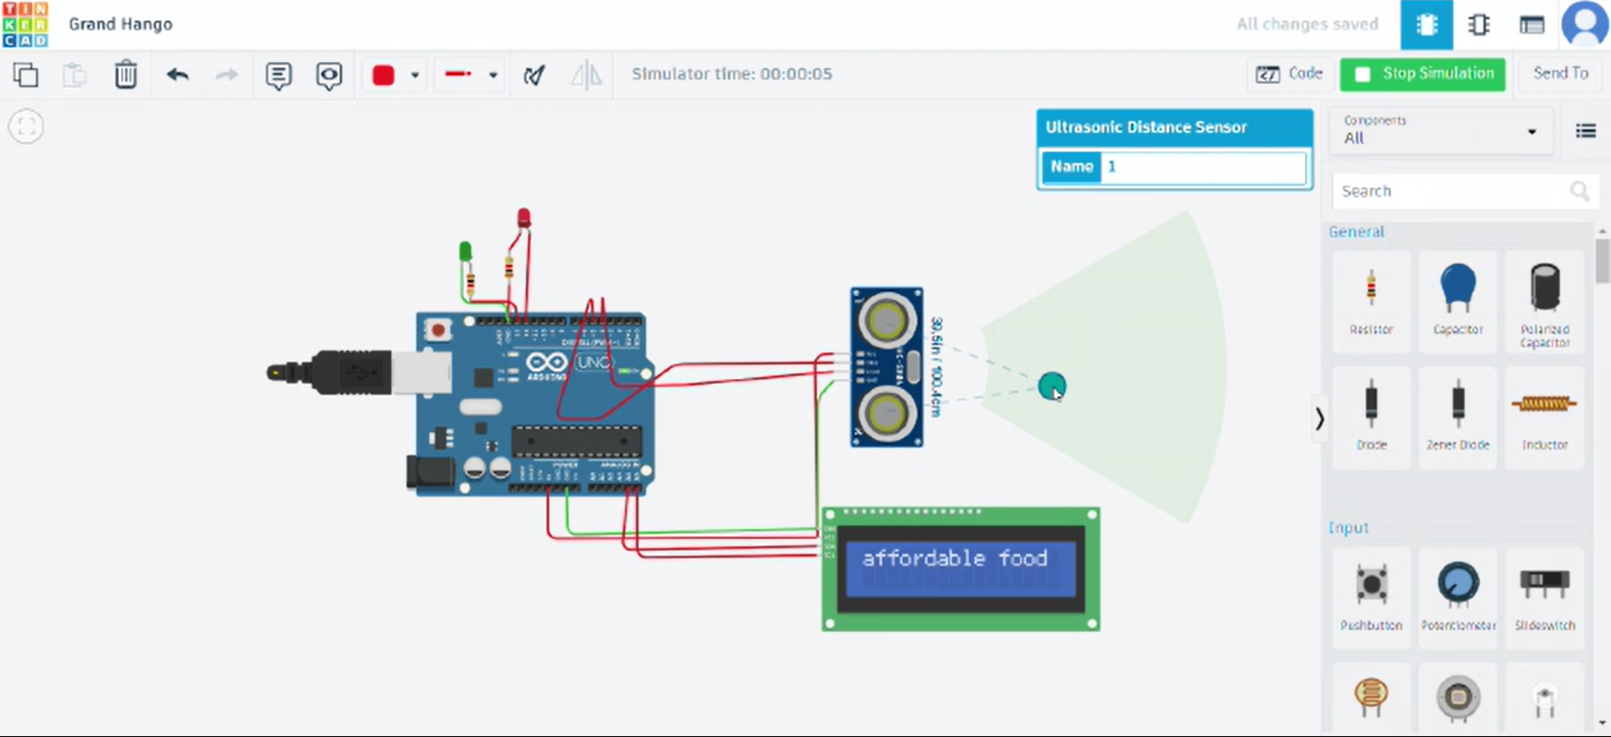
Unique submissions we received this month

Slide 9
Thank You
From IEEE UVCE PES

